Slide 1

Regression Analysis of Milk Production in the US
By Naif Alzahrani

Slide 2
The Idea
The amount of milk production.
The effect of the environment.
HOW?
USDA
Weather

Slide 3
The process
Scraping
Efficiency.
Fixing mistakes
EDA
None
Manual Editing
Features
Excel

Slide 4
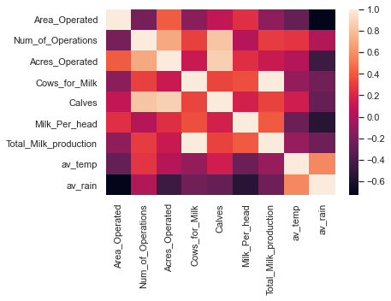
Correlations

Slide 5
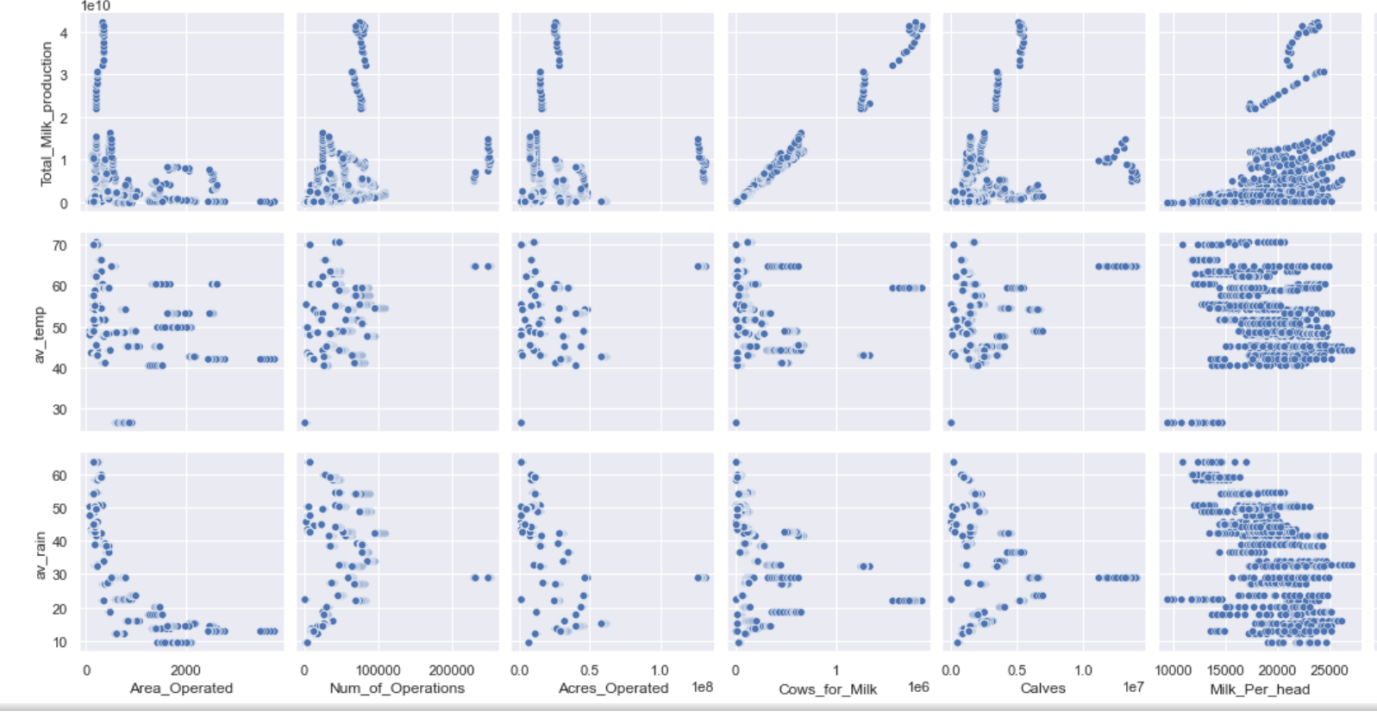
Pairplot

Slide 6

Coefficient of Determination
Split into train, val, and test
Linear Regression.
44
Create polynomial features.
Degree 2
93
Estimated coefficients for the linear regression.

Slide 7
